Slide 1
Housing Trends
Exploring Zillow data trends
making sense of a senseless housing market

Slide 2
Where are all the houses?
How many available houses are in the Arizona Market?
What does housing availability look like in Phoenix?
how has it changed?

Slide 3
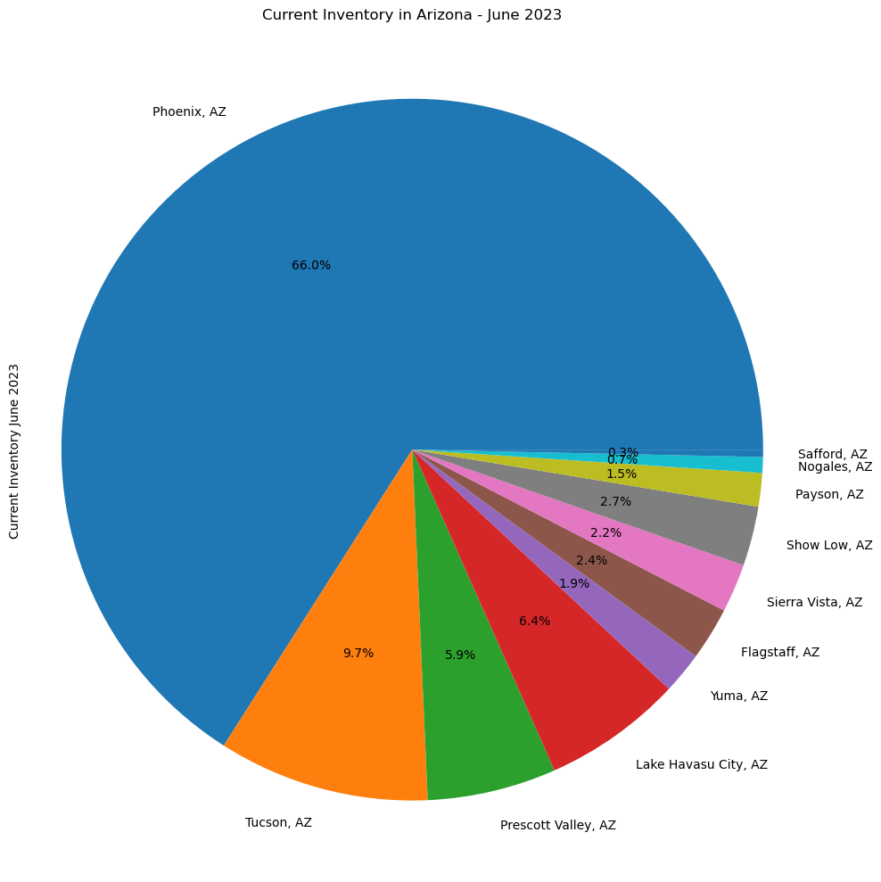
Arizona Housing Inventory
The Phoenix MSA has the largest single share of available housing and represents two-thirds of available inventory
Arizona does not have another city in the top 50 MSA, which may impact the significance of Phoenix’s inventory share
Investor tip: Lake Havasu City has a disproportionate number of houses for sale relative to the rest of the state with respect to population
Metro Area | Population Rank | Inventory Jun 2023
Phoenix, AZ | 11 | 16125 | 65.97%
Tucson, AZ | 54 | 2378 | 9.73%
Prescott Valley, AZ | 198 | 1452 | 5.94%
Lake Havasu City, AZ | 218 | 1569 | 6.42%
Yuma, AZ | 225 | 469 | 1.92%
Flagstaff, AZ | 302 | 596 | 2.44%
Sierra Vista, AZ | 335 | 547 | 2.24%
Show Low, AZ | 372 | 670 | 2.74%
Payson, AZ | 583 | 377 | 1.54%
Nogales, AZ | 625 | 177 | 0.72%
Safford, AZ | 718 | 82 | 0.34%

Slide 4
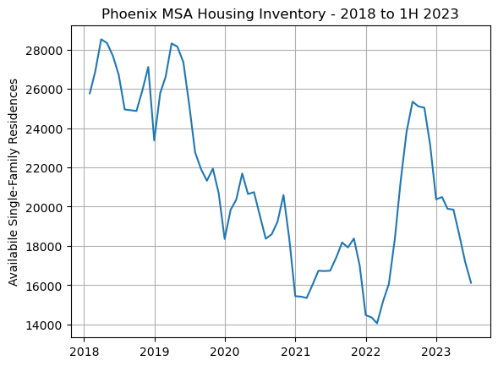
Spotlight: Inventory History of Phoenix
Phoenix has lost approximately 10,000 homes from the market since 2018
A post-pandemic rally in 2022 dramatically increased inventory but the gain was short lived
What happened in the market in 2022 to produce this trend?

Slide 5
Phoenix, et al.
Comparing Boston, San Francisco, Denver, Austin, and Phoenix:
How has inventory changed?
How have sale prices change?
Are these inputs related?

Slide 6
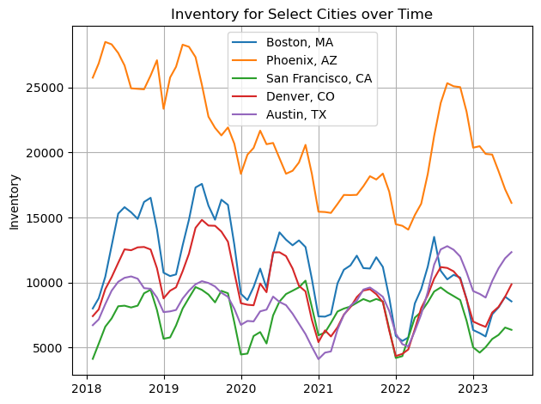
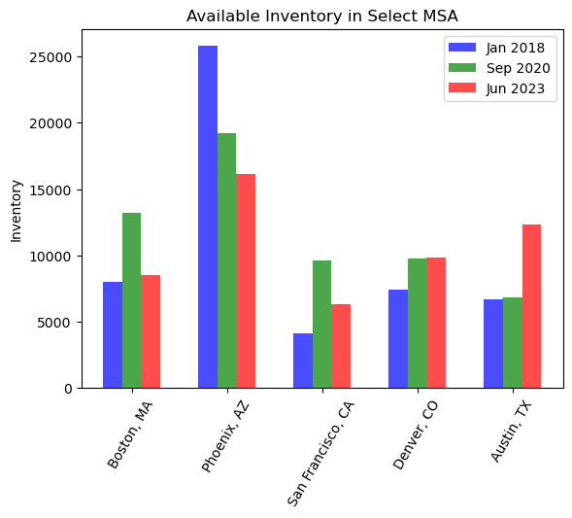
Inventory for the Select Five Cities
Inventory follows yearly cyclical patterns
Phoenix has drastically more available inventory historically, but the gap is closing
Phoenix saw the largest pre-to-post pandemic shrinkage
Austin, TX seems to have either cooled or built more housing

Slide 7
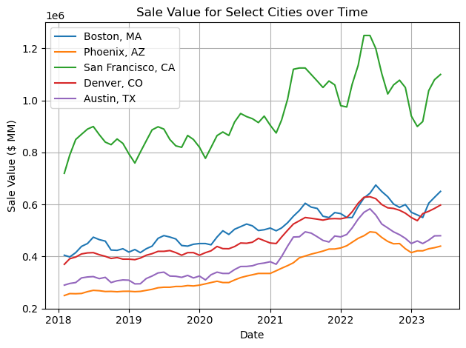
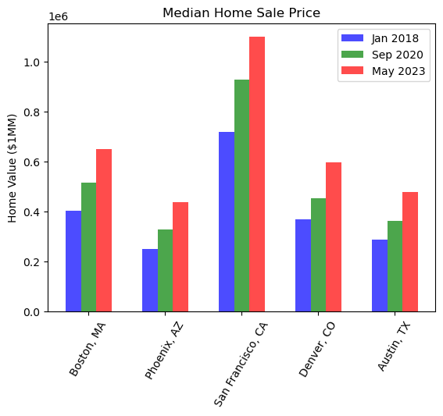
Sale Value for the Select Five Cities
Prices have steadily increased for all cities
San Francisco home prices may be showing signs of stability
Phoenix and Austin show similar trends for price increase
Prices do not look to be decreasing but potentially slowing

Slide 8
Sale Value and Inventory – Econ 101
Traditional macroeconomics states that supply and demand both affect the price of a good sold
Is there a relationship to the number of houses on the market and the sale price?
Initial hypothesis theorizes that prices should fall as inventory increases
As a reminder:
R-squared (R²) is a statistical measure that determines how well data fits a regression model
It's also known as the coefficient of determination
For example, an R-squared value of 0.9 means that 90% of the variance can be explained by the model features
The higher the R-squared value, the better the model fits the data.

Slide 9
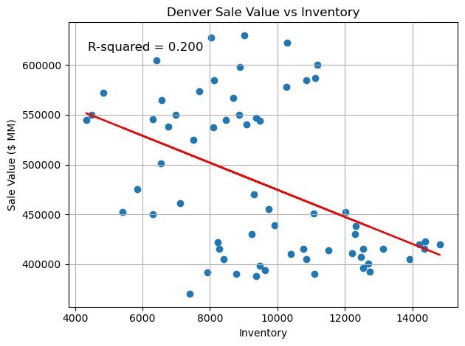
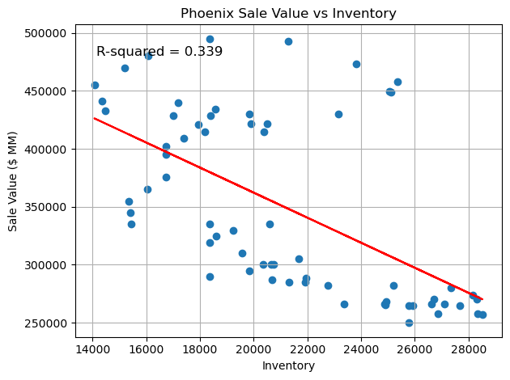
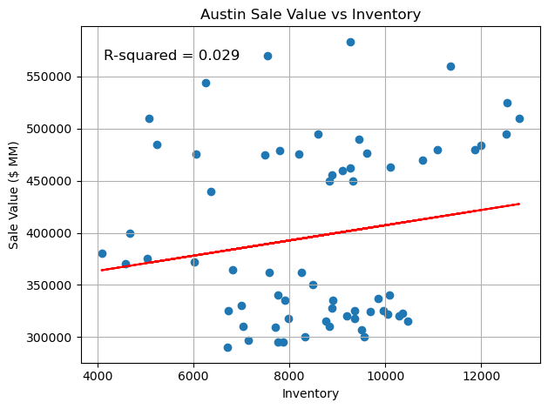
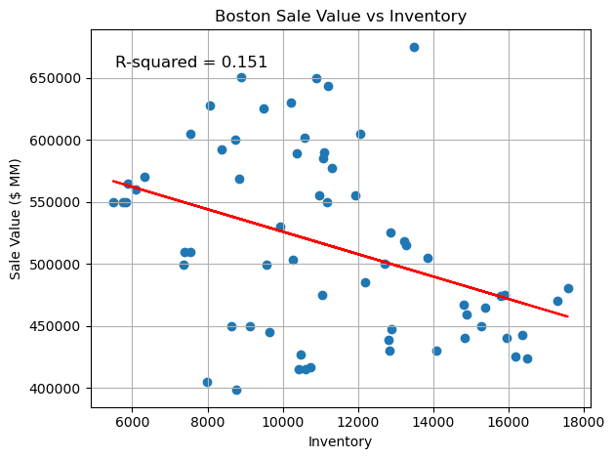
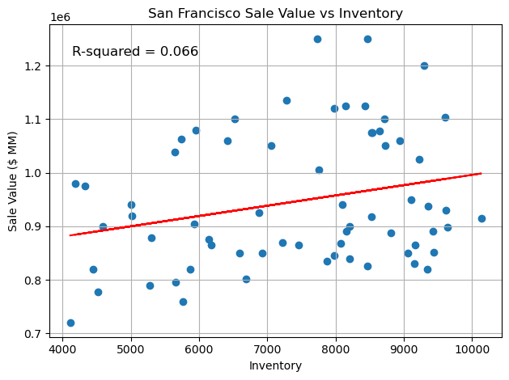
Sale Value and Inventory - Select MSA
Supply and Demand Hold True
Supply and Demand are Divorced

Slide 10
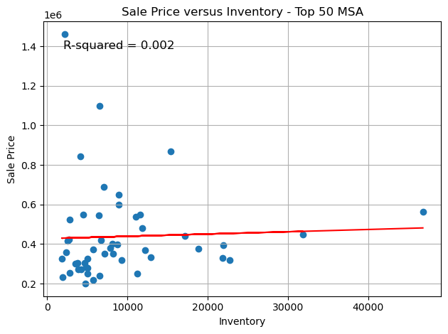
Housing as a Commodity?
Taking only the top 50 MSA, the relationship between Sale Price and Inventory is non-existent
This relationship suggests that housing cannot be modeled like a traditional commodity and the supply and demand relationship is not prevalent
What this means:
Home valuation is tied heavily to speculation
Property value is a large portion of most traditional personal assets
Volatility in the housing market increases risk on home buyers

Slide 11

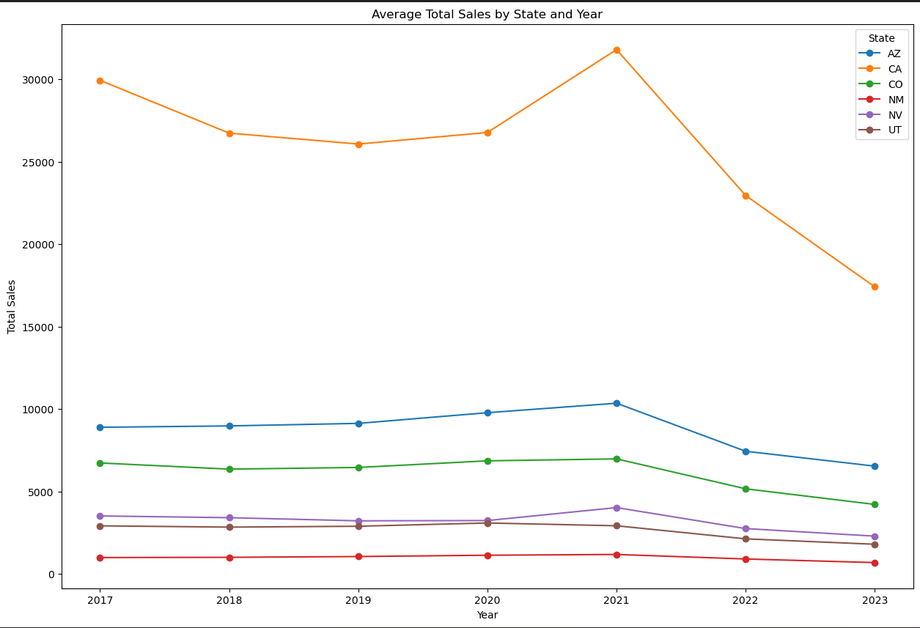
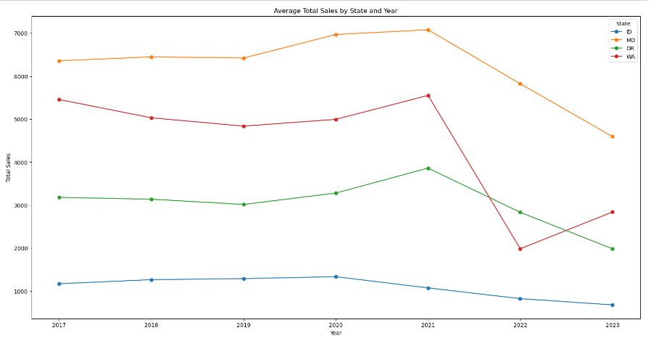
Total Home sale before and after Pandemic
5 years analysis on the southern and northern states.

Slide 12

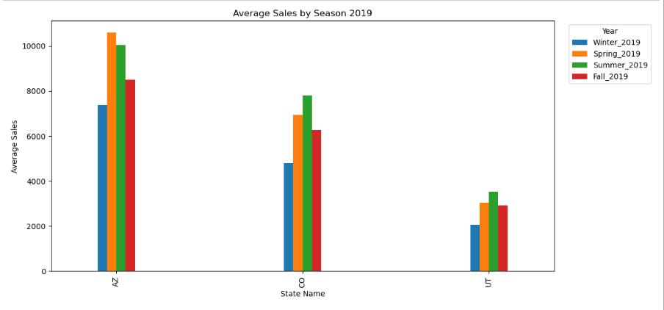
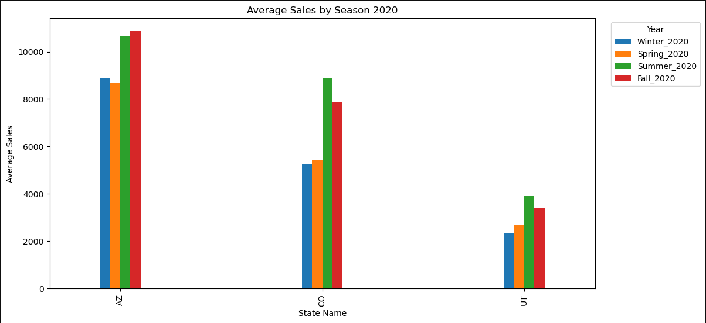


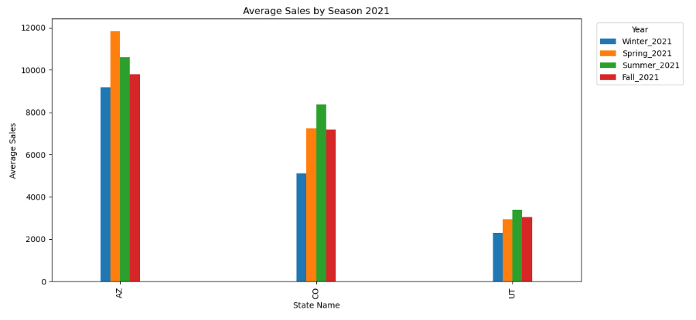
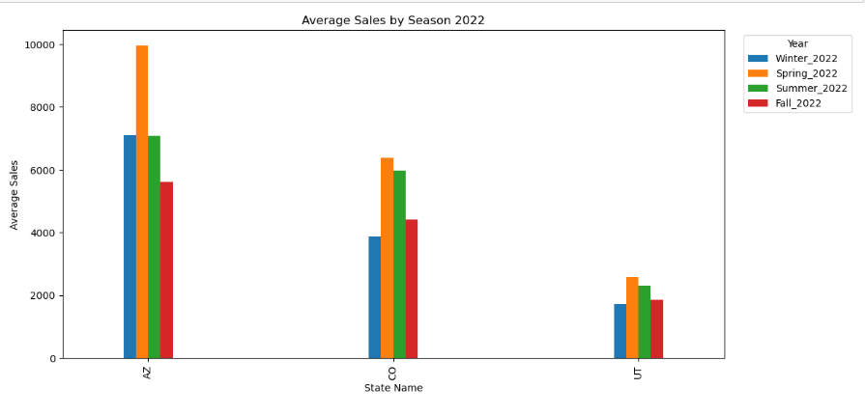

Seasonal Trend

Slide 13
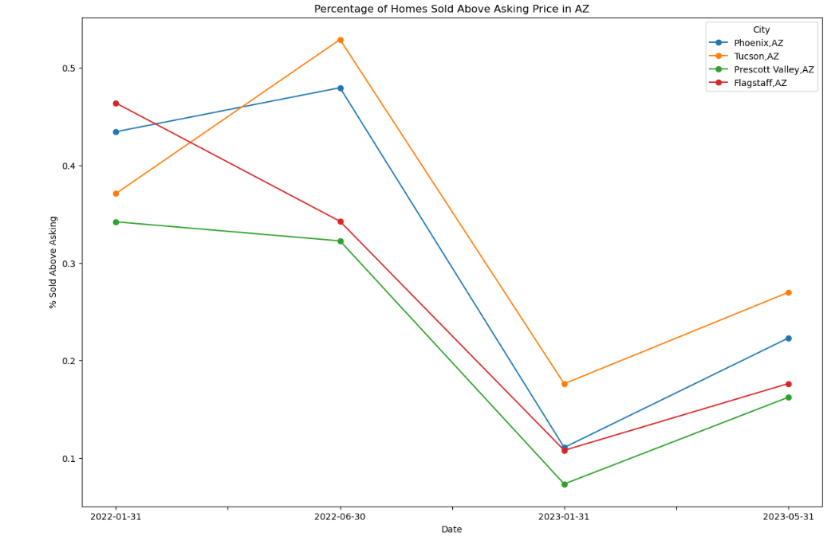
Percentage of Homes Sold Above Listing Price
Cities Included: Phoenix, Tucson, Prescott Valley, and Flagstaff
Highlight: Last Phoenix and Tucson saw close to 50% of listed homes being sold for over the asking price

Slide 14
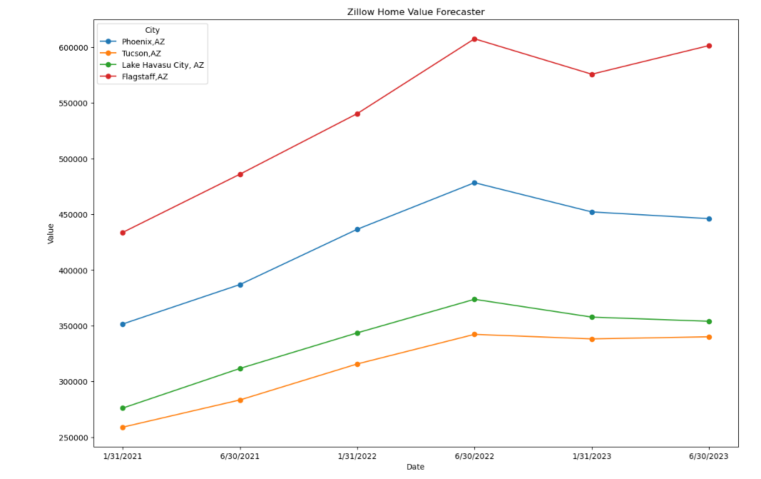
Zillow Home Value Forecaster
Cities Included: Phoenix, Tucson, Lake Havasu City, and Flagstaff
Highlight: Home values have been rising in value until the beginning of 2023 and have had some rebound since then

Slide 15
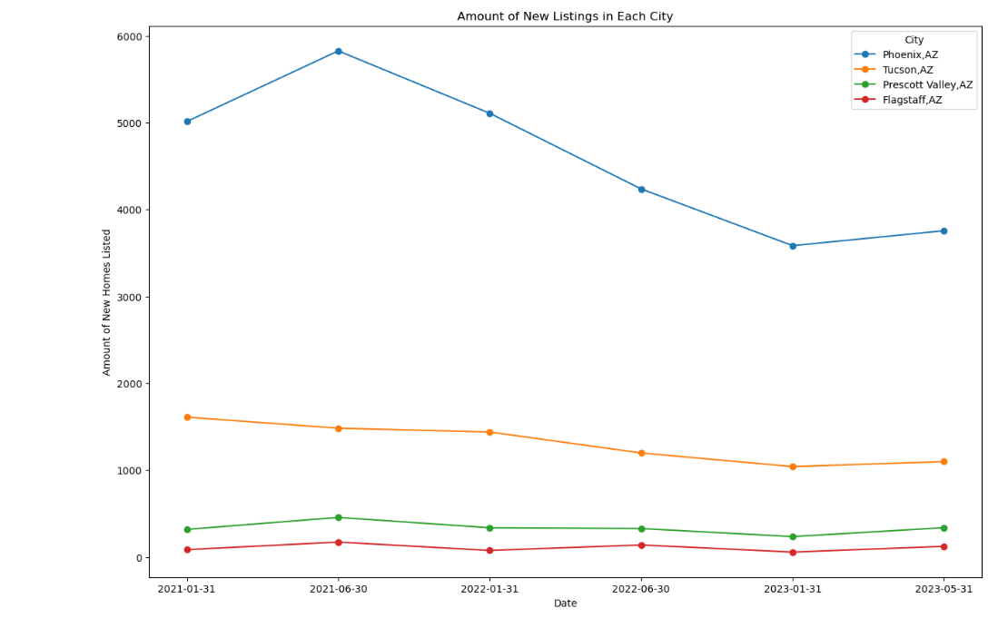
New Monthly Listings
Cities Included: Phoenix, Tucson, Prescott Valley, and Flagstaff
Highlight: Phoenix has a consistently higher rate of new monthly listing compared to the other cities.

